Slide 1
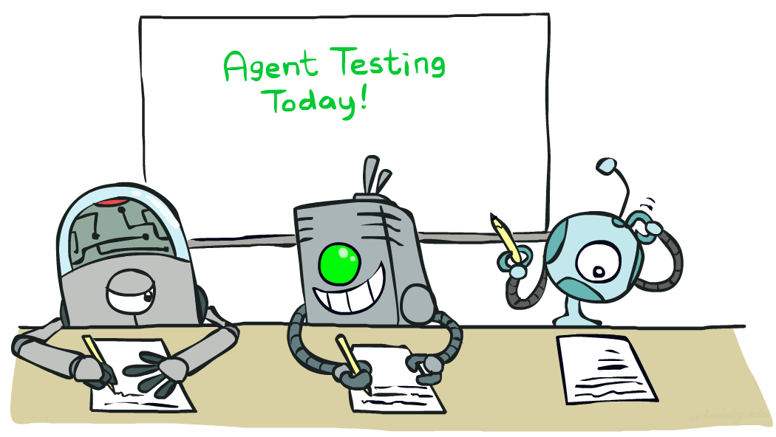

Naïve Bayes
[These slides were created by Dan Klein, Pieter Abbeel, Sergey Levine, with some materials from A. Farhadi. ai.berkeley.edu ]
Notes:
Please retain proper attribution, including the reference to ai.berkeley.edu. Thanks!
‹#›

Slide 2
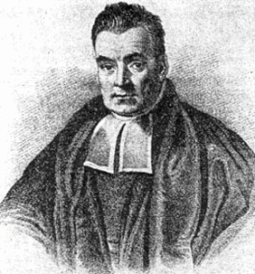
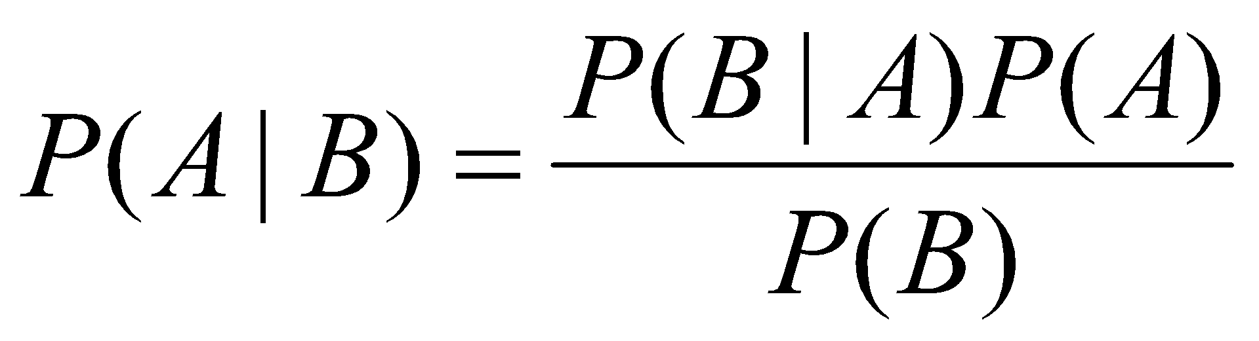
Bayes Rule
The product rule gives us two ways to factor a joint probability:
Therefore,
Why is this useful?
Can update our beliefs about A based on evidence B
P(A) is the prior and P(A|B) is the posterior
Key tool for probabilistic inference: can get diagnostic probability from causal probability
E.g., P(Cavity = true | Toothache = true) from P(Toothache = true | Cavity = true)
Rev. Thomas Bayes (1702-1761)

Slide 3
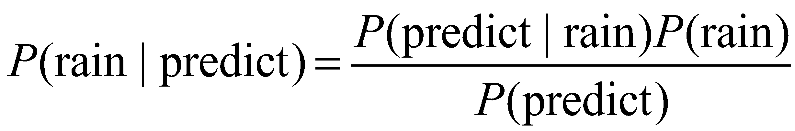
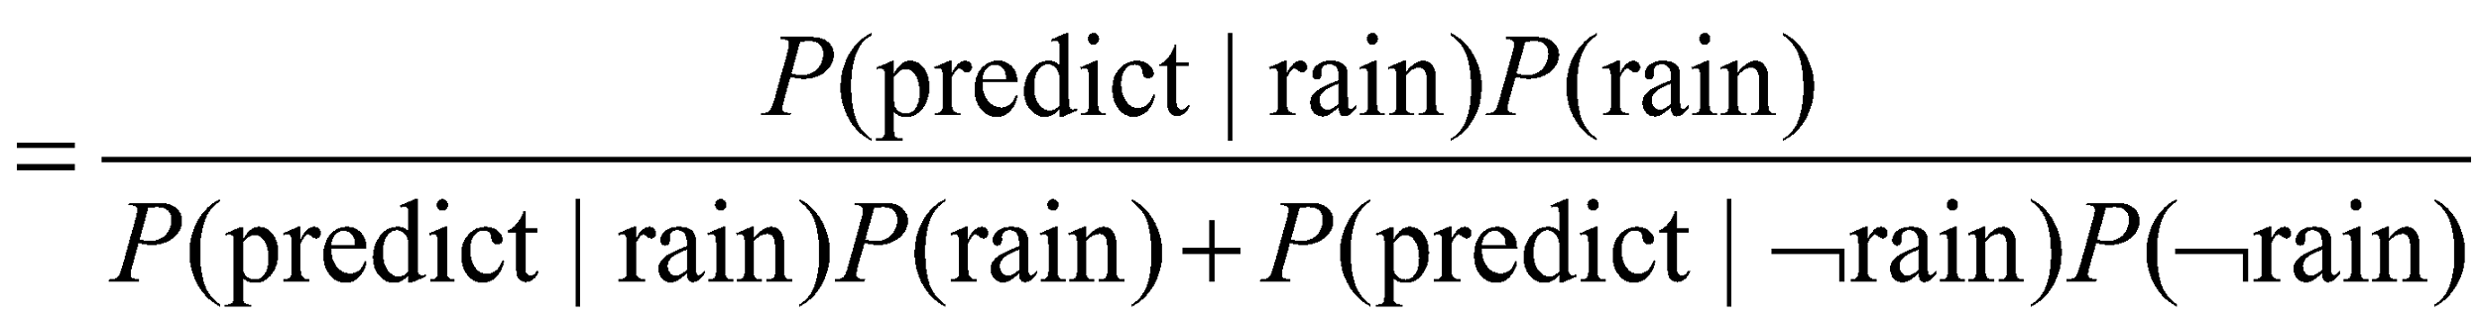
Bayes Rule example
In recent years, it has rained only 5 days each year (5/365 = 0.014) in the desert. The weatherman has predicted rain for tomorrow. When it actually rains, the weatherman correctly forecasts rain 90% of the time. When it doesn't rain, he incorrectly forecasts rain 10% of the time. What is the probability that it will rain tomorrow?

Slide 4
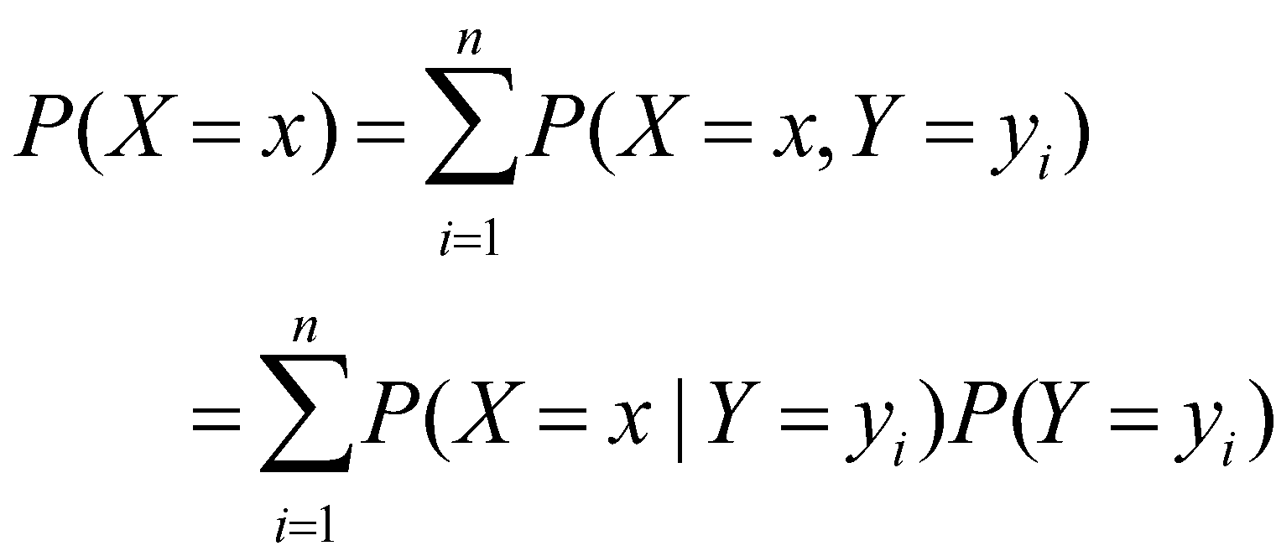
Law of total probability

Slide 5
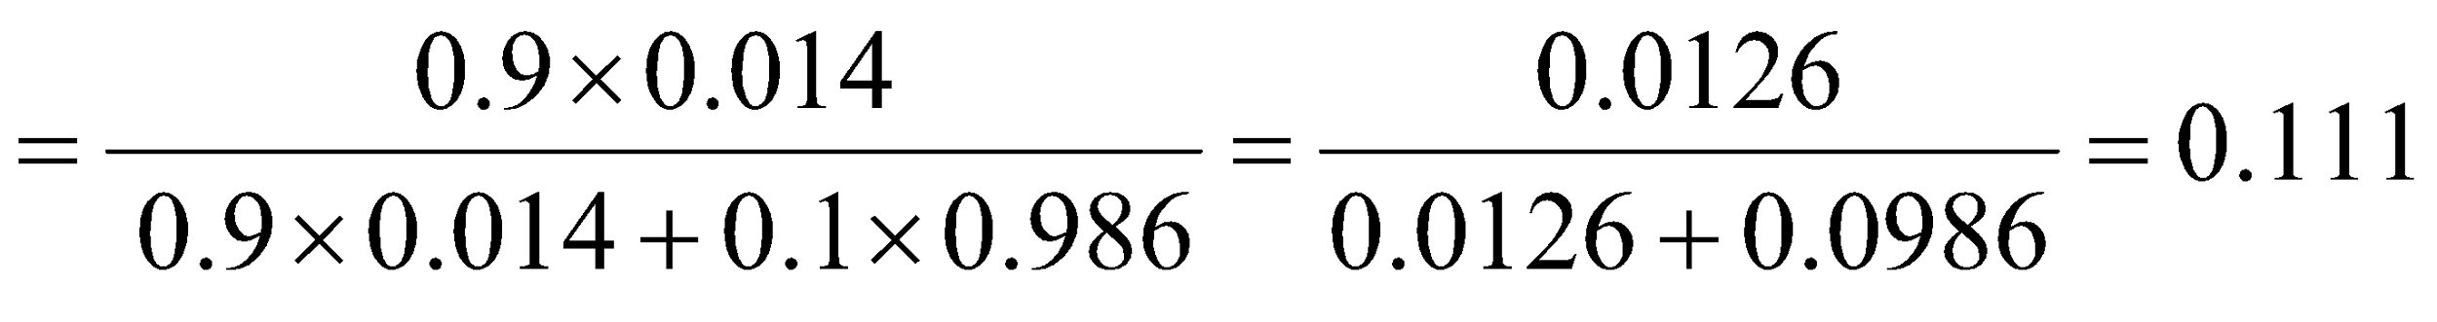
Bayes Rule example
In recent years, it has rained only 5 days each year (5/365 = 0.014) in the desert. The weatherman has predicted rain for tomorrow. When it actually rains, the weatherman correctly forecasts rain 90% of the time. When it doesn't rain, he incorrectly forecasts rain 10% of the time. What is the probability that it will rain tomorrow?
Notes:
‹#›

Slide 6
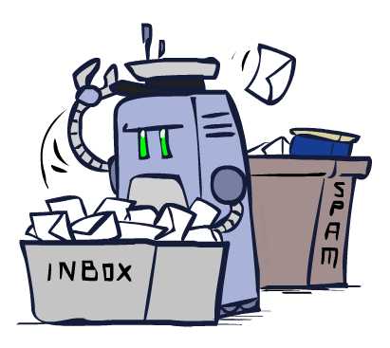
Classification

Slide 7
Example: Spam Filter
Input: an email
Output: spam/ham
Setup:
Get a large collection of example emails, each labeled “spam” or “ham”
Note: someone has to hand label all this data!
Want to learn to predict labels of new, future emails
Features: The attributes used to make the ham / spam decision
Words: FREE!
Text Patterns: $dd, CAPS
Non-text: SenderInContacts
…
Dear Sir.
First, I must solicit your confidence in this transaction, this is by virture of its nature as being utterly confidencial and top secret. …
TO BE REMOVED FROM FUTURE MAILINGS, SIMPLY REPLY TO THIS MESSAGE AND PUT "REMOVE" IN THE SUBJECT.
99 MILLION EMAIL ADDRESSES
FOR ONLY $99
Ok, Iknow this is blatantly OT but I'm beginning to go insane. Had an old Dell Dimension XPS sitting in the corner and decided to put it to use, I know it was working pre being stuck in the corner, but when I plugged it in, hit the power nothing happened.

Slide 8

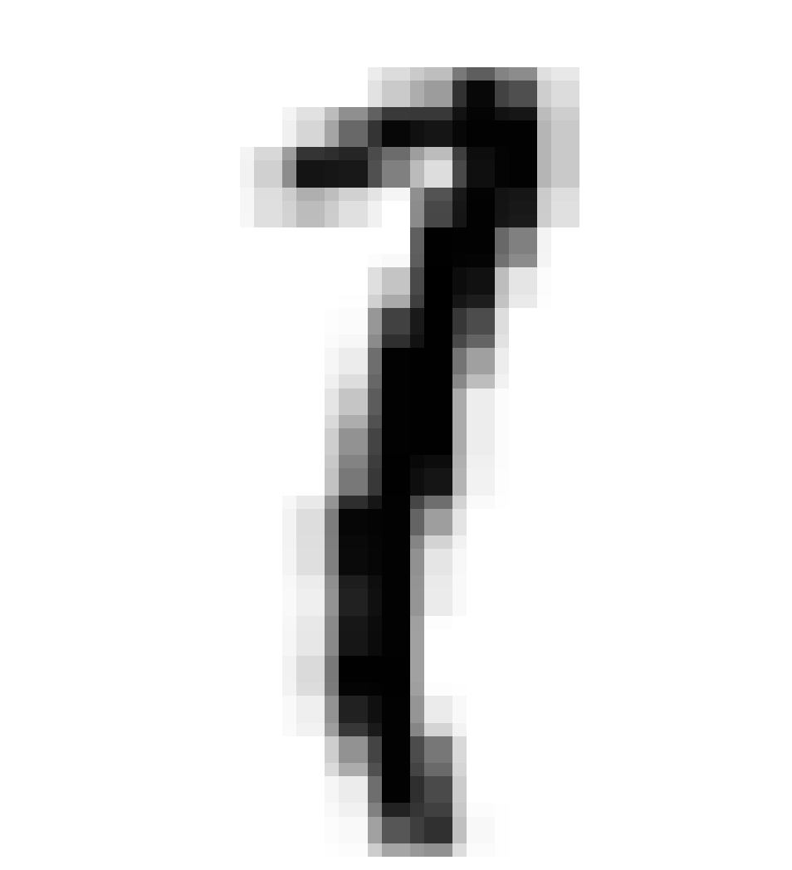



Example: Digit Recognition
Input: images / pixel grids
Output: a digit 0-9
Setup:
Get a large collection of example images, each labeled with a digit
Note: someone has to hand label all this data!
Want to learn to predict labels of new, future digit images
Features: The attributes used to make the digit decision
Pixels: (6,8)=ON
Shape Patterns: NumComponents, AspectRatio, NumLoops
…
0
1
2
1
??
Notes:
‹#›

Slide 9
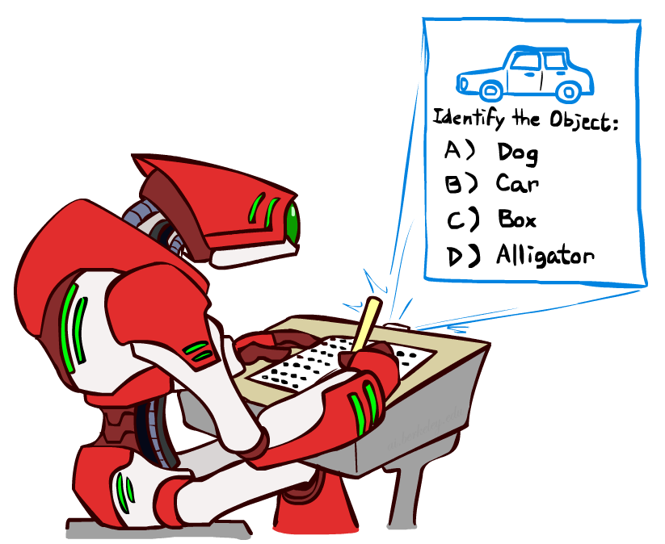
Other Classification Tasks
Classification: given inputs x, predict labels (classes) y
Examples:
Spam detection (input: document,
classes: spam / ham)
OCR (input: images, classes: characters)
Medical diagnosis (input: symptoms,
classes: diseases)
Automatic essay grading (input: document,
classes: grades)
Fraud detection (input: account activity,
classes: fraud / no fraud)
Customer service email routing
… many more
Classification is an important commercial technology!

Slide 10
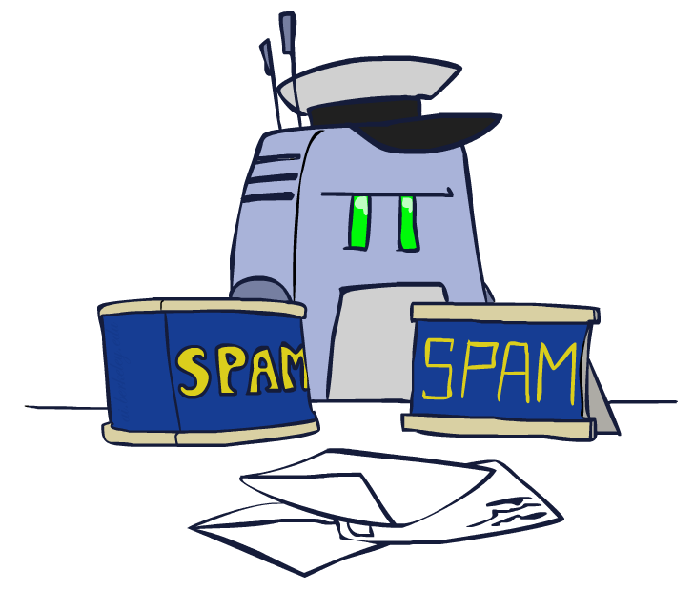
Model-Based Classification

Slide 11
Model-Based Classification
Model-based approach
Build a model (e.g. Bayes’ net) where both the label and features are random variables
Instantiate any observed features
Query for the distribution of the label conditioned on the features
Challenges
What structure should the model have?
How should we learn its parameters?

Slide 12


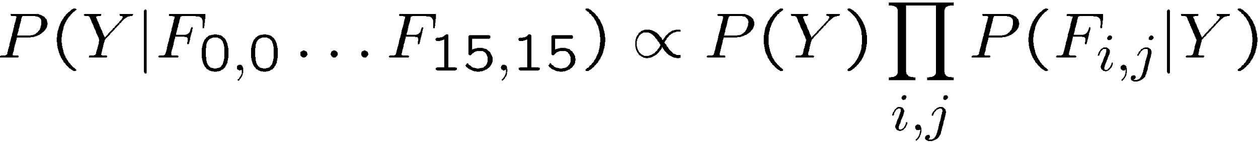
Naïve Bayes for Digits
Naïve Bayes: Assume all features are independent effects of the label
Simple digit recognition version:
One feature (variable) F_{ij} for each grid position <i,j>
Feature values are on / off, based on whether intensity
is more or less than 0.5 in underlying image
Each input maps to a feature vector, e.g.
Here: lots of features, each is binary valued
Naïve Bayes model:
Y
F₁
F₂
F_{n}

Slide 13
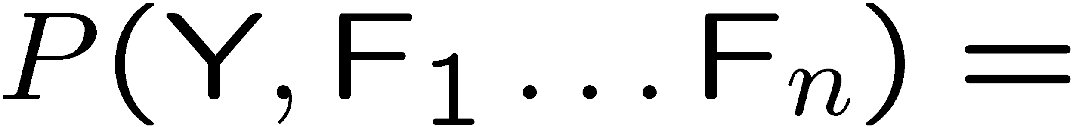
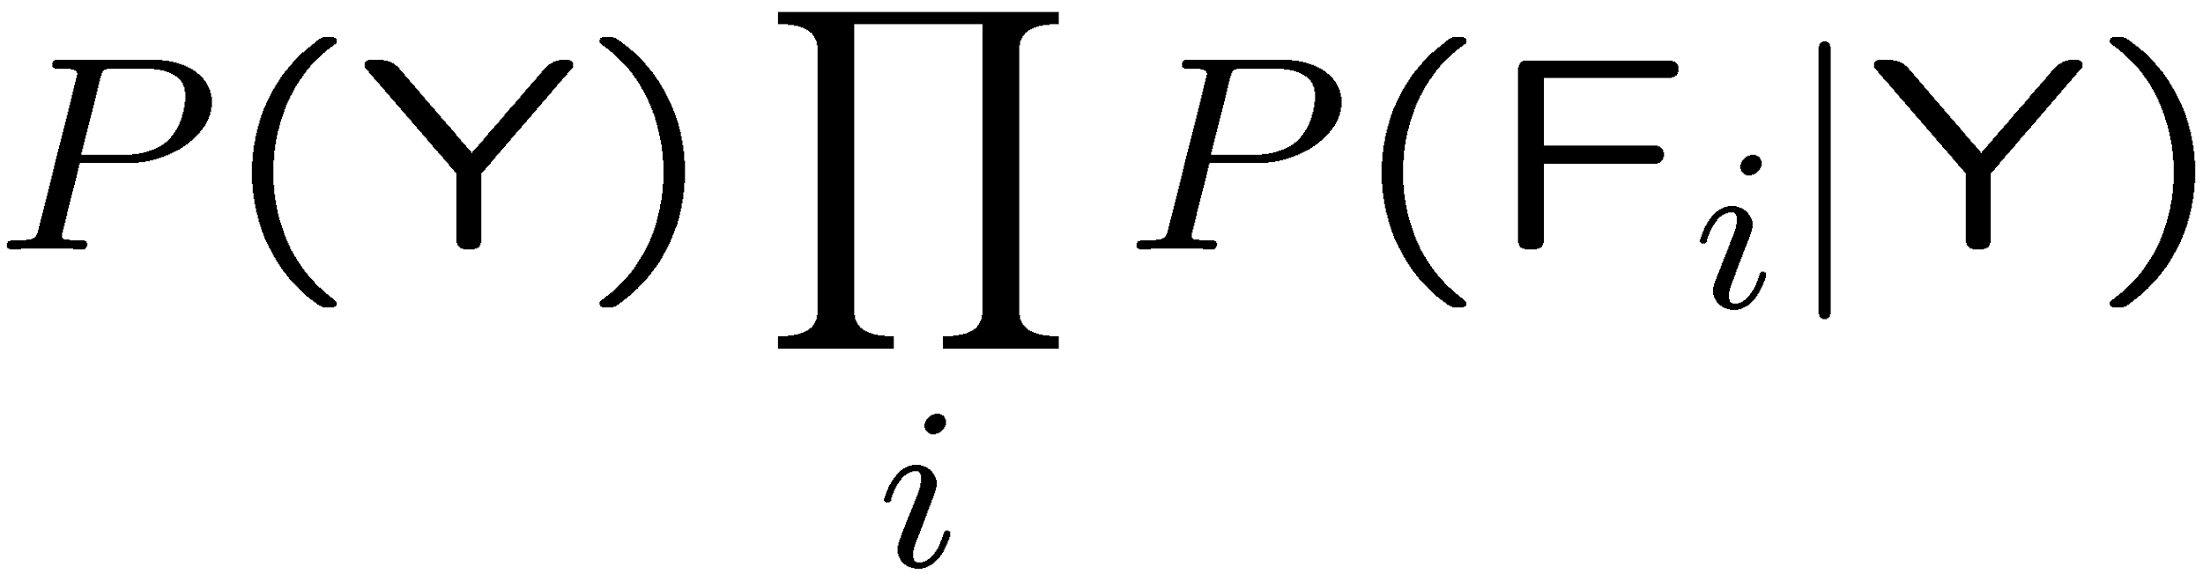
General Naïve Bayes
A general Naive Bayes model:
We only have to specify how each feature depends on the class
Total number of parameters is linear in n
Model is very simplistic, but often works anyway
Y
|Y| parameters
F₁
F₂
F_{n}
|Y| x |F|^{n} values
n x |F| x |Y| parameters

Slide 14
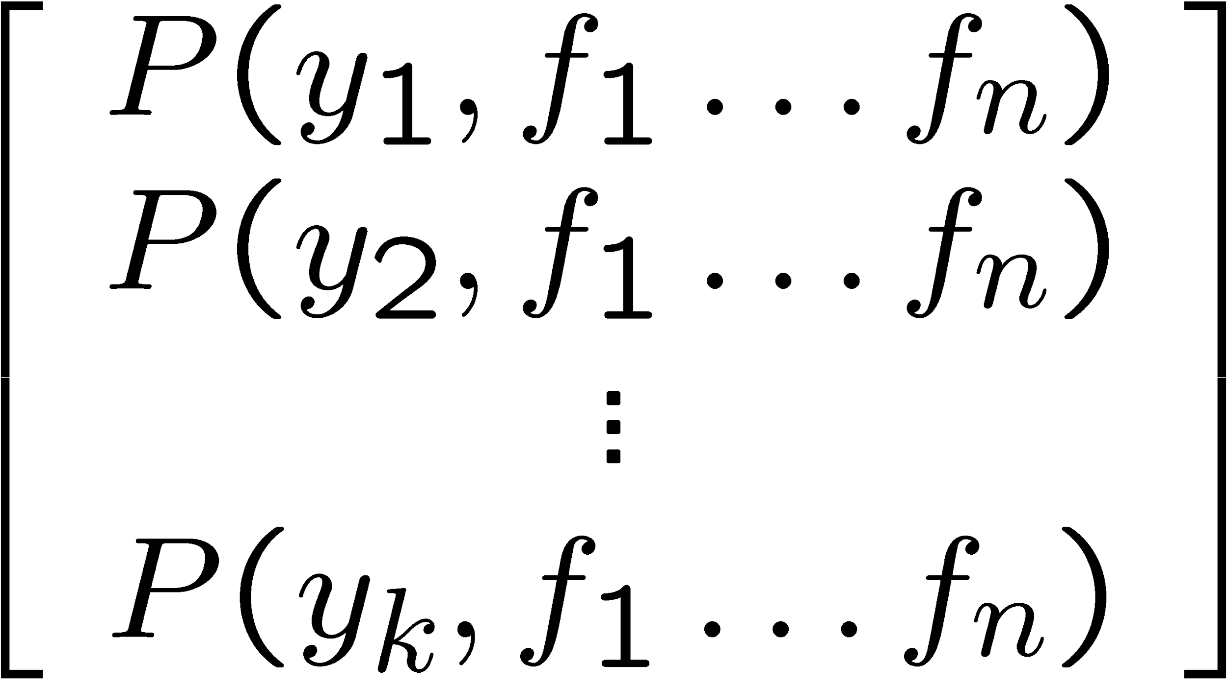
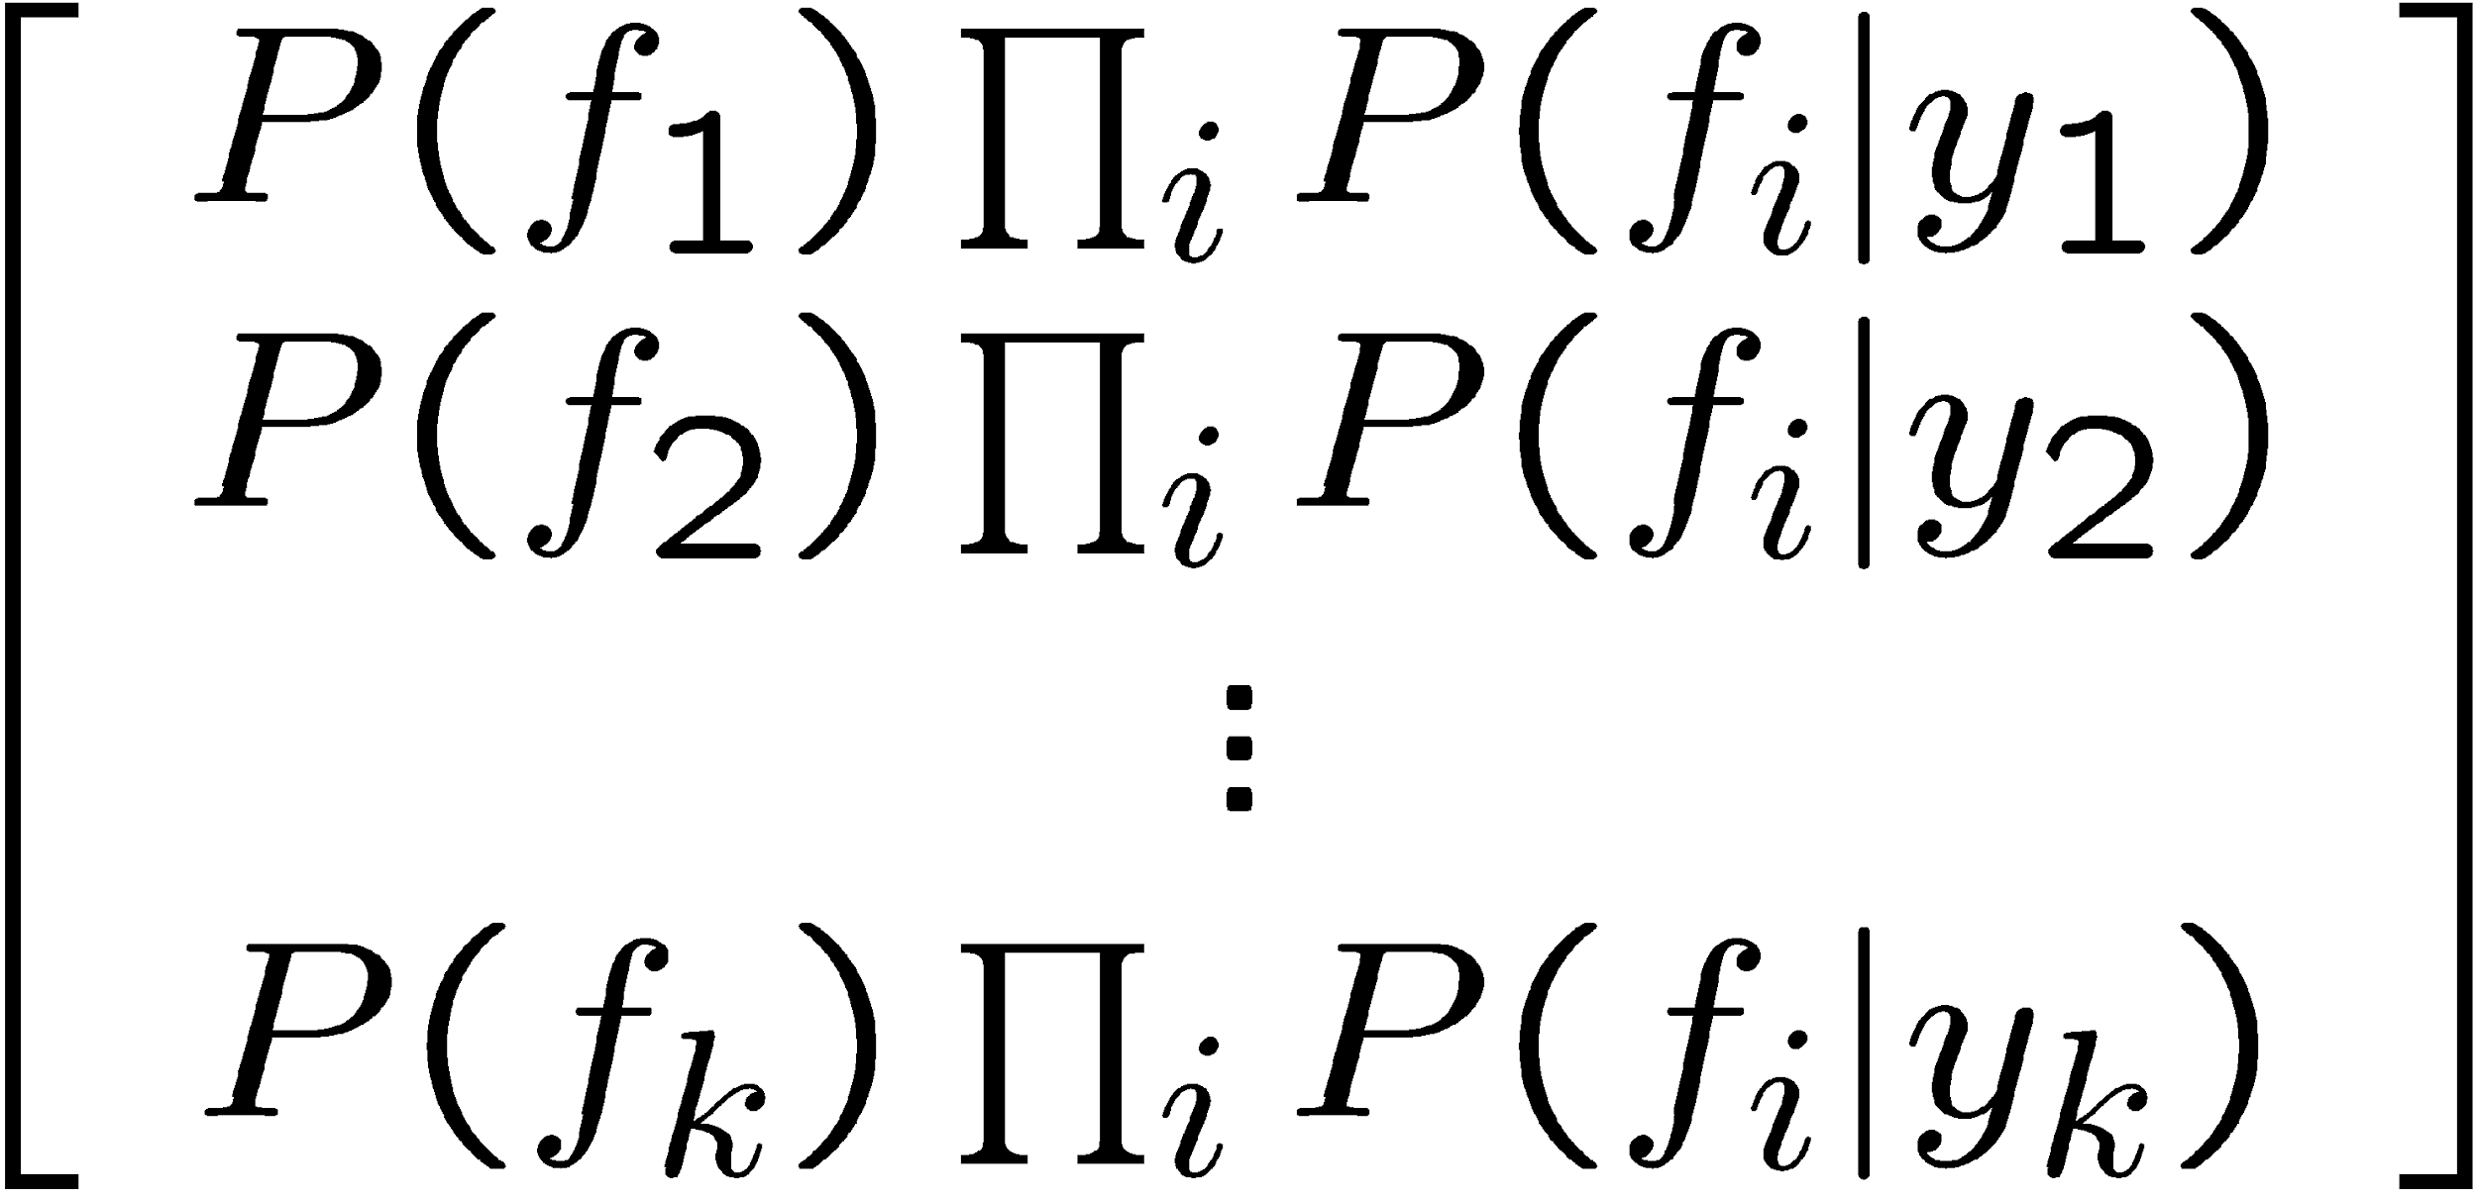
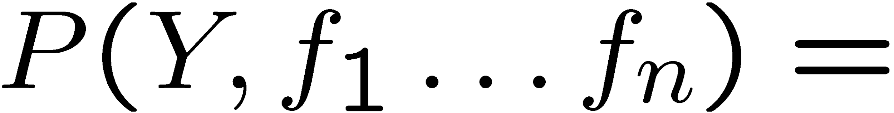
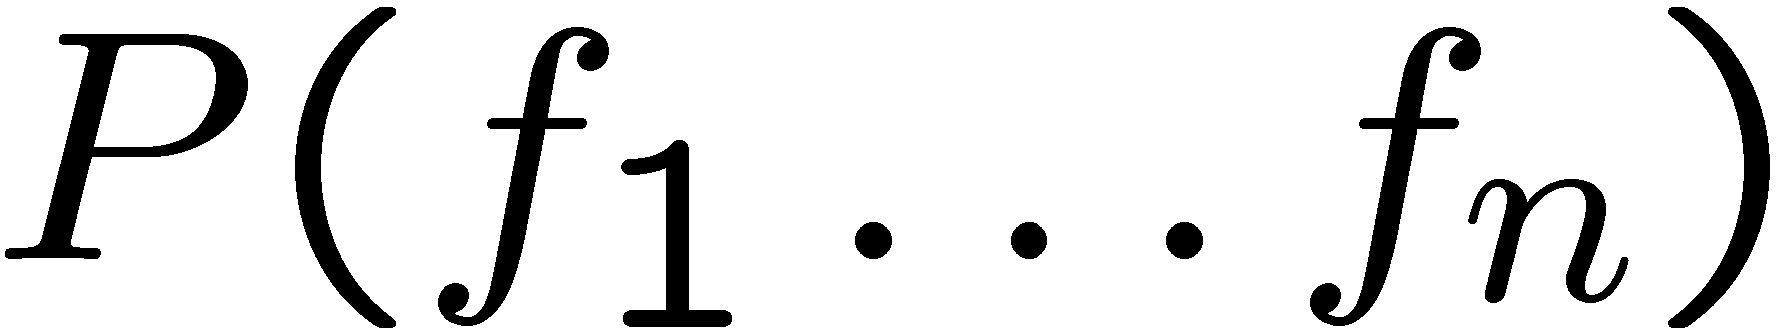
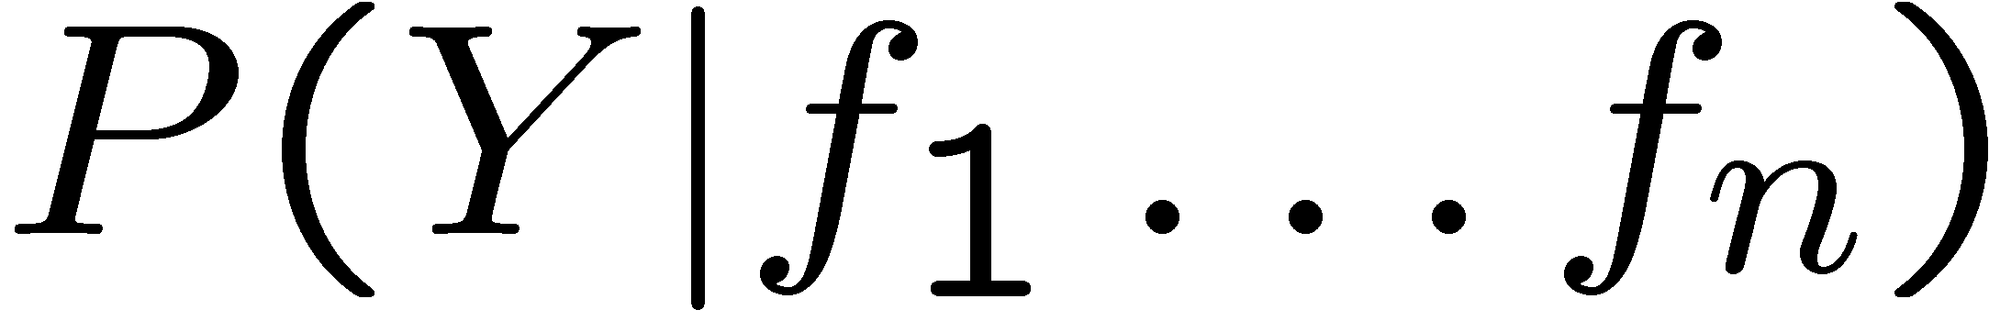
Inference for Naïve Bayes
Goal: compute posterior distribution over label variable Y
Step 1: get joint probability of label and evidence for each label
Step 2: sum to get probability of evidence
Step 3: normalize by dividing Step 1 by Step 2
+

Slide 15
General Naïve Bayes
What do we need in order to use Naïve Bayes?
Inference method (we just saw this part)
Start with a bunch of probabilities: P(Y) and the P(F_{i}|Y) tables
Use standard inference to compute P(Y|F₁…F_{n})
Nothing new here
Estimates of local conditional probability tables
P(Y), the prior over labels
P(F_{i}|Y) for each feature (evidence variable)
These probabilities are collectively called the parameters of the model
Up until now, we assumed these appeared by magic, but…

Slide 16
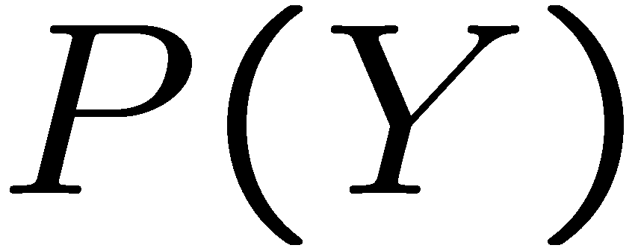


Example: Conditional Probabilities
1 | 0.1
2 | 0.1
3 | 0.1
4 | 0.1
5 | 0.1
6 | 0.1
7 | 0.1
8 | 0.1
9 | 0.1
0 | 0.1
1 | 0.01
2 | 0.05
3 | 0.05
4 | 0.30
5 | 0.80
6 | 0.90
7 | 0.05
8 | 0.60
9 | 0.50
0 | 0.80
1 | 0.05
2 | 0.01
3 | 0.90
4 | 0.80
5 | 0.90
6 | 0.90
7 | 0.25
8 | 0.85
9 | 0.60
0 | 0.80

Slide 17
A Spam Filter
Naïve Bayes spam filter
Data:
Collection of emails, labeled spam or ham
Note: someone has to hand label all this data!
Split into training, held-out, test sets
Classifiers
Learn on the training set
(Tune it on a held-out set)
Test it on new emails
Dear Sir.
First, I must solicit your confidence in this transaction, this is by virture of its nature as being utterly confidencial and top secret. …
TO BE REMOVED FROM FUTURE MAILINGS, SIMPLY REPLY TO THIS MESSAGE AND PUT "REMOVE" IN THE SUBJECT.
99 MILLION EMAIL ADDRESSES
FOR ONLY $99
Ok, Iknow this is blatantly OT but I'm beginning to go insane. Had an old Dell Dimension XPS sitting in the corner and decided to put it to use, I know it was working pre being stuck in the corner, but when I plugged it in, hit the power nothing happened.

Slide 18
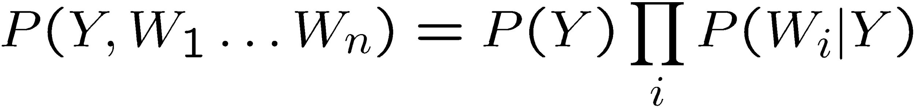
Naïve Bayes for Text
Bag-of-words Naïve Bayes:
Features: W_{i} is the word at positon i
As before: predict label conditioned on feature variables (spam vs. ham)
As before: assume features are conditionally independent given label
New: each W_{i} is identically distributed
Generative model:
“Tied” distributions and bag-of-words
Usually, each variable gets its own conditional probability distribution P(F|Y)
In a bag-of-words model
Each position is identically distributed
All positions share the same conditional probs P(W|Y)
Why make this assumption?
how many variables are there?
how many values?
Word at position i, not i^{th} word in the dictionary!
When the lecture is over, remember to wake up the
person sitting next to you in the lecture room.
in is lecture lecture next over person remember room
sitting the the the to to up wake when you

Slide 19

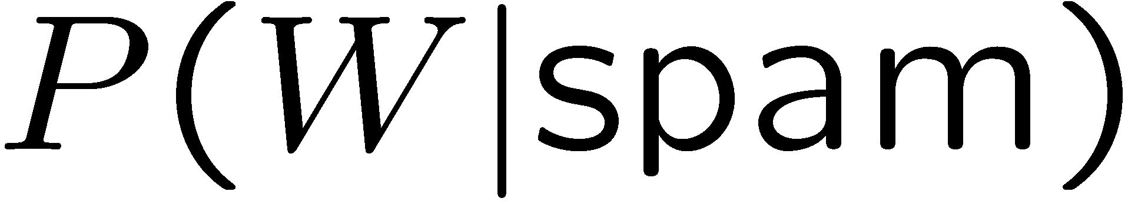
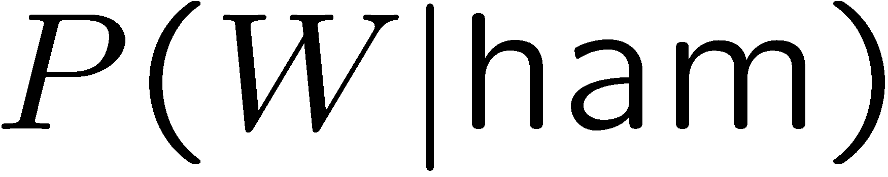
Example: Spam Filtering
Model:
What are the parameters?
Where do these tables come from?
ham : 0.66
spam: 0.33
the : 0.0156
to : 0.0153
and : 0.0115
of : 0.0095
you : 0.0093
a : 0.0086
with: 0.0080
from: 0.0075
...
the : 0.0210
to : 0.0133
of : 0.0119
2002: 0.0110
with: 0.0108
from: 0.0107
and : 0.0105
a : 0.0100
...

Slide 20



Spam Example
Word | P(w|spam) | P(w|ham) | Tot Spam | Tot Ham
(prior) | 0.33333 | 0.66666 | -1.1 | -0.4
Gary | 0.00002 | 0.00021 | -11.8 | -8.9
would | 0.00069 | 0.00084 | -19.1 | -16.0
you | 0.00881 | 0.00304 | -23.8 | -21.8
like | 0.00086 | 0.00083 | -30.9 | -28.9
to | 0.01517 | 0.01339 | -35.1 | -33.2
lose | 0.00008 | 0.00002 | -44.5 | -44.0
weight | 0.00016 | 0.00002 | -53.3 | -55.0
while | 0.00027 | 0.00027 | -61.5 | -63.2
you | 0.00881 | 0.00304 | -66.2 | -69.0
sleep | 0.00006 | 0.00001 | -76.0 | -80.5
P(spam | w) = 98.9

